Slide 1

Are Customers Addicted to Sales at J.C.Penny ?
消费者是否沉迷于杰西潘尼的销售？

Slide 2
BRIEF INTRODUCTION
ABOUT
J.C.Penney

Slide 3
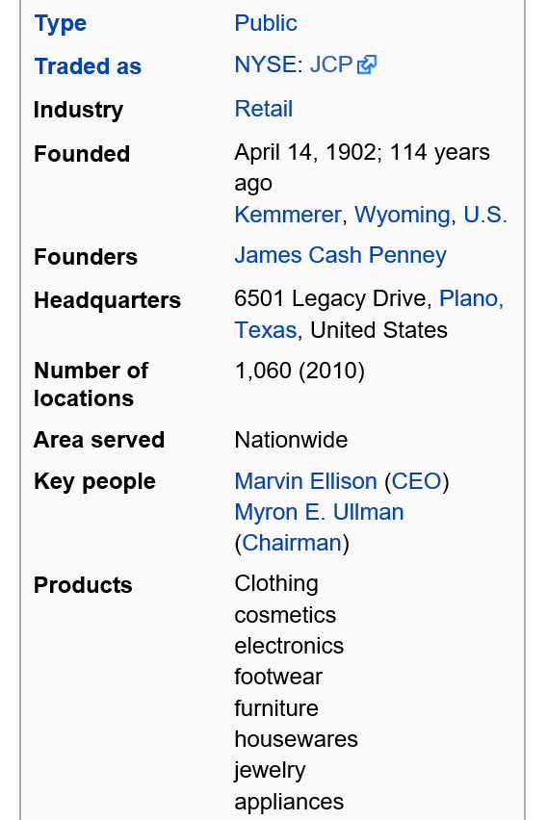
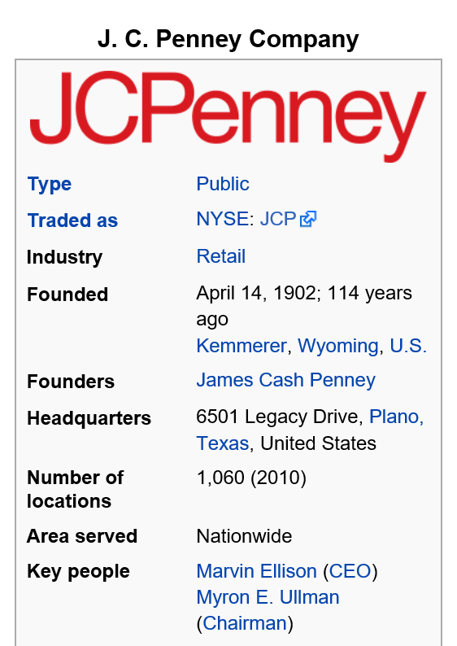
BRIEF INTRODUCTION
ABOUT
J.C.Penny
The J.C.Penney is one of the biggest department stores （百货商店）with 1,060 locations in 49 U.S. States and Puerto Rico. Also, J.C.Penney is one of the top 500 companies in the world

Slide 4
HISTORY

Slide 5
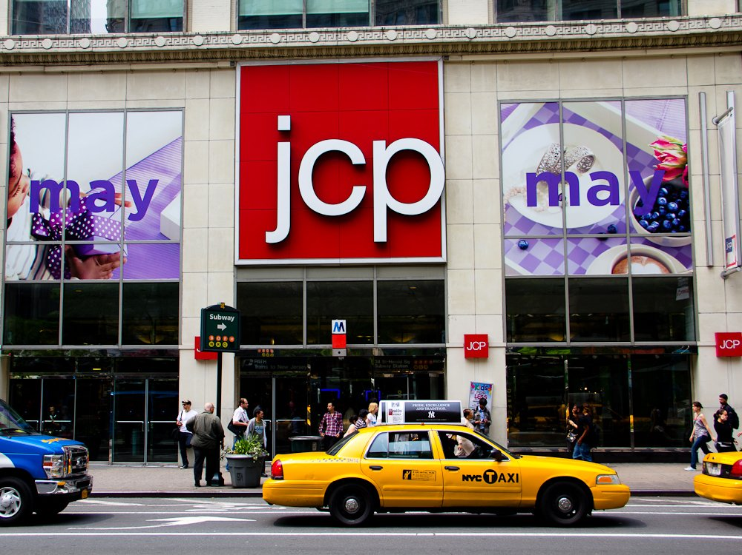
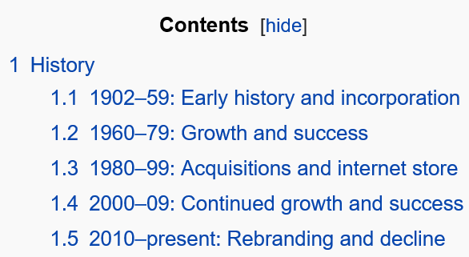
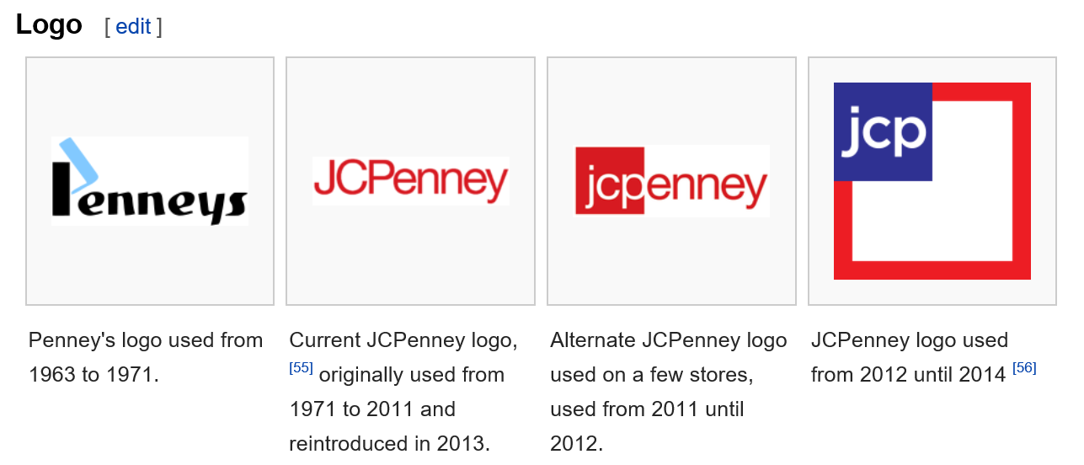
HISTORY
e
Founded by James Cash Penney in the early 1900s in Kemmerer, Wyoming, JCPenney was originally called the Golden Rule store（黄金法则店）. The bedrock of Mr. Penney’s business philosophy was to treat customers fairly and honestly（营销哲学是真诚公平地对待顾客） by following the Golden Rule:
Do unto others as you would have them do unto you.
像你希望别人如何对待你一样对待别人
Penney’s philosophy and innovative merchandising practices quickly led to success

Slide 6
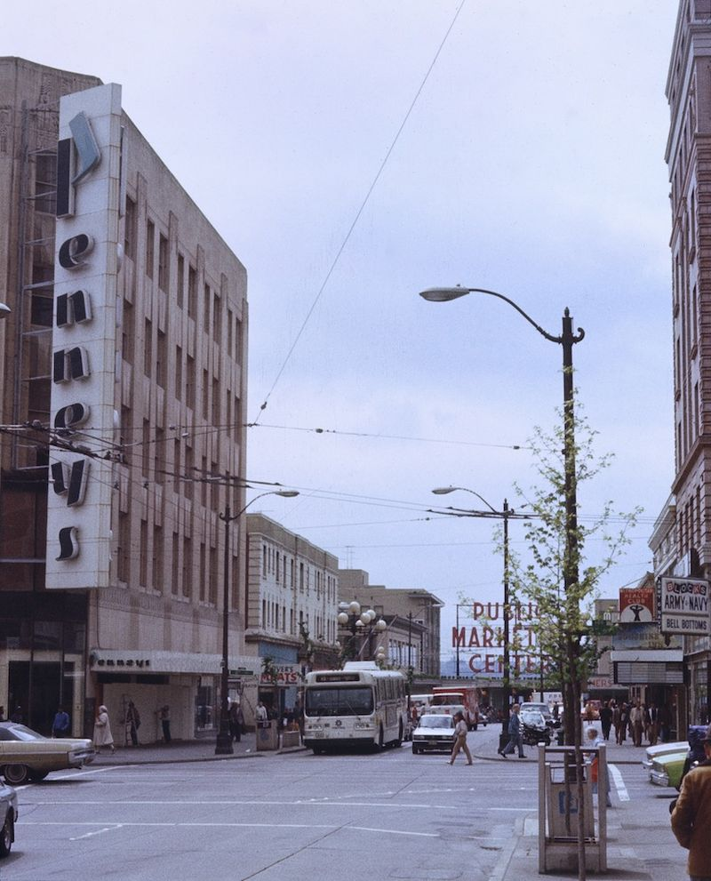
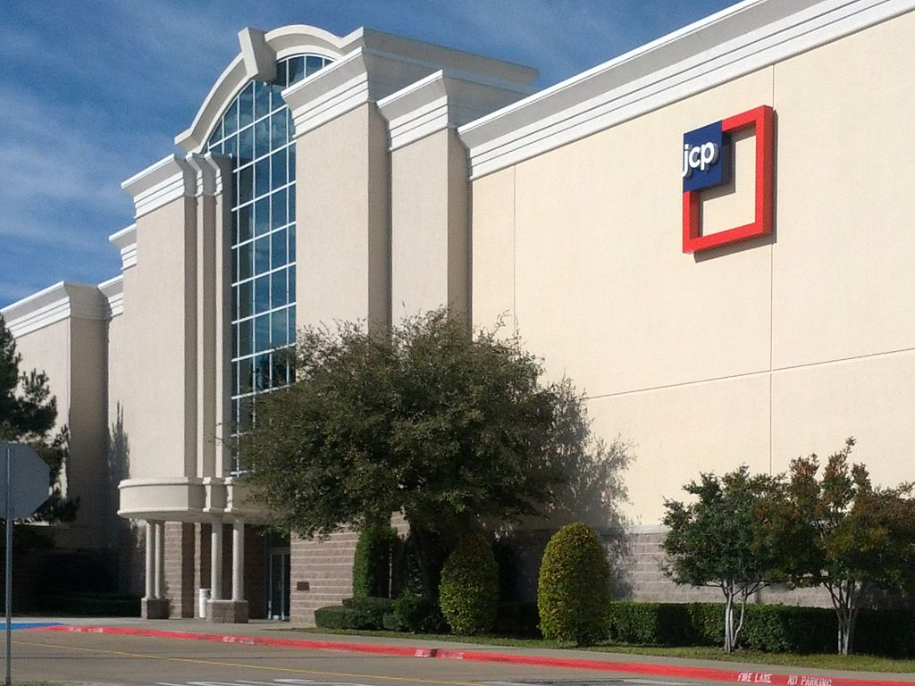

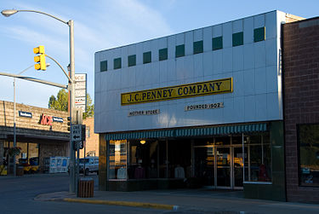
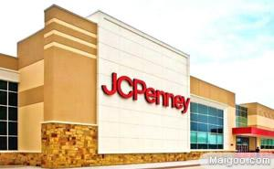
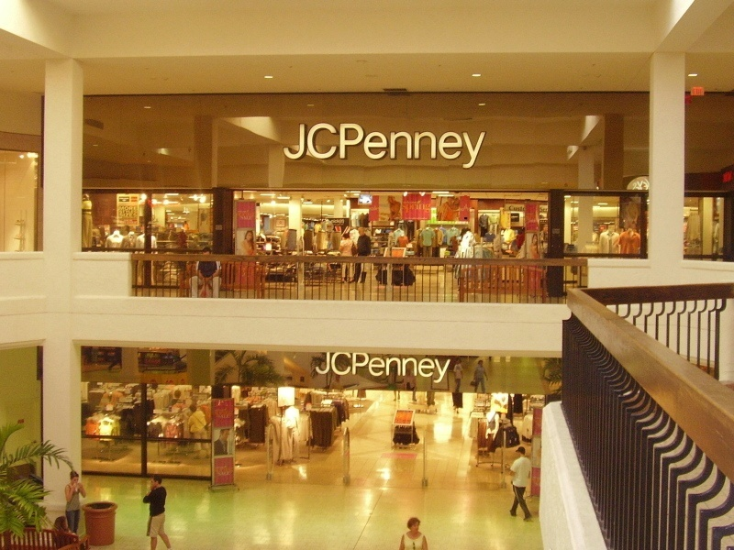
The former Downtown Seattle store in 1982, with signage from the period when the chain was branded as Penneys and used a more stylized font in its logo. Pike Place Market is in the background
J.C. Penney mother store in Kemmerer, Wyoming in September 2007.
JCPenney in Aventura Mall in Aventura, Florida in February 2006.
JCPenney big-box store in Houston, Texas in October 2009.
A two-story J. C. Penney at Stonebriar Centre in Frisco, Texas in January 2013, opened in 2000.
JCPenney headquarters in Plano, Texas.

Slide 7
CASE REVIEW
案例回顾

Slide 8
CASE REVIEW
1
Changing Retail Landscape
2
New Management, Drastic Changes
3
Fall Out And Backpedaling

Slide 9
CHANGING RETAIL LANDSCAPE
变幻的零售业环境

Slide 10
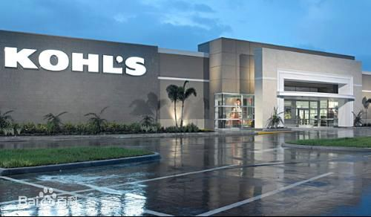
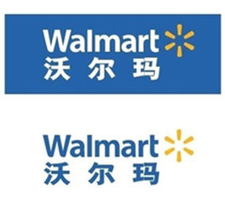

CHANGING RETAIL LANDSCAPE
Competitors
竞争者
The Great Recession
经济萧条
Decline
衰落
The Great Recession（经济大萧条） that began in 2007 also bruised JCPenney. Annual revenue（年收入） dropped from $19.9 billion in 2007 to $17.3 billion in 2011. During the same four-year span, earnings dropped from $1.1 billion to a net loss（净亏损） of $152 million. These losses caused JCPenney’s stock to slide（股票下跌） and facilitated the shuttering of its catalog channel（加速目录渠道的关闭）.
By the 1990s, competitors had encroached on JCPenney’s mid-market position. Competitors’ success took a heavy toll on JCPenney’s sales, and by 2012, the number of JCPenney stores had been pared to （下降）1100.

Slide 11
New
Management,
Drastic
Change
新管理· 剧变

Slide 12
过度的促销和折扣导致前景黯淡
高折扣：Close to three-quarters of JCPenney’s merchandise was sold at a discount of 50 percent or more（4分之3的商品以高于或等于50%的折扣售出）.
频繁的促销活动：JCPenney had run more than 590 salesin 2011, significantly driving up operating expenses and eroding maintain markup（590次促销，提高了运营成本，削弱了维持盈利的能力）.
顾客忠诚度低：JCPenney customer made only four purchases a year. Customers were purchasing relatively infrequently（顾客购买频率下降）; and when they did purchase, the merchandise was heavily discounted（只在打折的时候购买）.

Slide 13
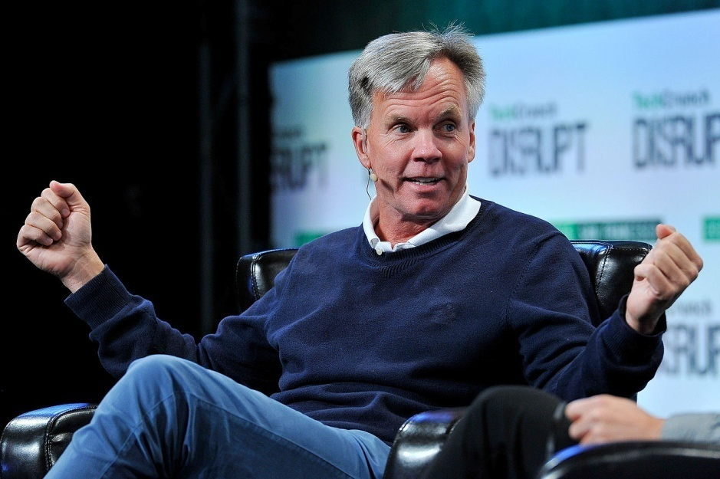
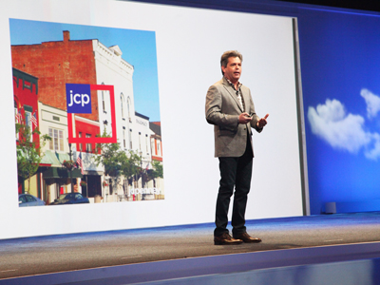
过度的促销和折扣导致前景
雇佣新的CEO和董事长
JCPenney’s board of directors fired CEO Myron Ullman III and replaced him with Ron Johnson（更换CEO）, a former Apple executive（苹果总经理）, who had also served as the head of merchandising for Target（塔吉特商品销售主管）. Johnson assumed office in November 2011. To assist him in turning JCPenney’s operations around, Johnson hired Michael Francis, the chief marketing officer for Target（塔吉特首席行销官）, to be JCPenney’s president（更换总裁）. Francis was viewed as one of the architects of Target’s popular, hip image.

Slide 14
过度的促销和折扣导致前景黯淡
雇佣新的CEO 和董事长
围绕三个核心手段提出新的价格策略：“公平合理”
Johnson称新的价格策略是对以往大打折扣和特殊事件定价的一个根本性背离，取而代之的是：
“Fair and Square” ——公平合理定价
1、one “fair” price that would reflect a minimum 40 percent discount from the previous, nondiscounted price（一个“Fair”的价格，不打折商品价格最低为以前价格的6折）
2、 a month-long “value” price, where selected merchandise would be discounted up to 30 percent for an entire month（一个月的“Value”的价格，被选定的商品在整整一个月内可以打折到30%）
3、 a “best” price that would be available on the first and third Friday of every month that reflected a discount of up to 40 percent on the “fair” price（一个“Best”的价格，可以在每个月第一和第三个周五使用，呈现高达40%的“公平”的价格折扣）.

Slide 15
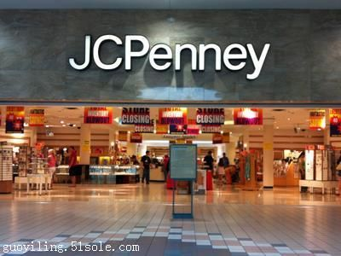
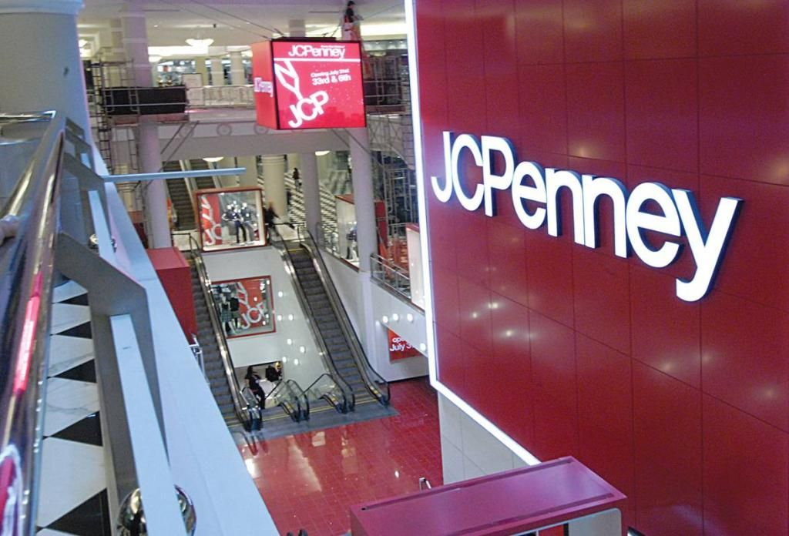
过度的促销和折扣导致前景黯淡
雇佣新的CEO 和董事长
围绕三个核心手段提出新的价格策略：“公平合理”
提出新的商品推销规划和店铺布局
1、the stores would be redesigned around the “Town Square” (城市广场)theme, where each store would have a centralized Town Square.
2、 Also, stores would be remodeled into the store-in-store layout（店中店布局）, where different brand shops, would have dedicated space within the store.

Slide 16
过度的促销和折扣导致前景黯淡
雇佣新的CEO 和董事长
围绕三个核心手段提出新的价格策略：“公平合理”
提出新的商品推销规划和店铺布局
新的标志
A new red-square logo with the letters JCP in the upper-left-hand corner was unveiled to emphasize the “fair and square” pricing theme.

Slide 17
Fall Out
And
Backpedaling
衰落和背弃

Slide 18
Fall Out
And
Backpedaling
The new strategy did not
resonate with（产生共鸣） consumers
It seemed to be driving JCPenney’s customers into the competition’s stores.
JCPenney’s second quarter 2012 financial performance（业绩表现） was even poorer. But its competitors, seem to be faring much better

Slide 19
2012.6 Michael Francis, who abruptly resigned from（突然辞职） his position. 2012.8 Johnson sent an e-mail to JCPenney customers indicated that there would be no shift in strategy.（战略不变）
Third quarter 2012 sales results resulted in even more losses for JCPenney（损失更多）.
2012.8 the month-long price reduction（持续一个月的减价） initiative was terminated with（终结） Johnson claiming it was too confusing for shoppers（对消费者来说太困惑了）.
2013.1 the real reversal of “Fair and Square” began（重启“公平合理”定价）. JCPenney announced that it was going to commence running sales again（重新开始促销）.
At the same time, Johnson restated（重申） that JCPenney would not resume the practice of distributing coupons（不会再实行分发优惠券）. Decided to implement reference pricing by adding new MSRP price tags（决定使用参考定价/建议零售价） to more than half its merchandise.

Slide 20
Q1: What environmental factors contributed to JCPenney’s “Fair and Square” launch?什么样的环境因素促成了杰西潘尼的“公平合理”推出？
2、内部环境分析：
（1）、Bad sales performance . 企业销售业绩显著下滑
（2）、Internal operation was not optimistic.内部运作情况不乐观。
（3）、High-low pricing and heavy discount was not a good marketing strategies.以往高-低定价和大打折扣的营销方式并没有产生在顾客之间产生良好的效益
（4）、Customers purchasing and customers royalty slid rapidly.（顾客购买量和顾客忠诚度迅速下跌）
1、宏观环境分析：
（1）、Competitors: 业内竞争者的出现：Macy’s （梅西百货 ），Kohl’s, Walmart（沃尔玛），Target（塔吉特）等。
（2）、Economy: 经济态势：2007年的经济大萧条导致美国消费者消费能力下降，对消费者的消费预期产生的负面影响；同时，美国零售业销售总额逐月下降，众多企业裁员倒闭，但有一些零售业店面逆势扩张，以经济实惠的折扣店为主。（The Great Recession that began in 2007 also bruised JCPenney. Annual revenue dropped from $19.9 billion in 2007 to $17.3 billion in 2011. During the same four-year span, earnings dropped from $1.1 billion to a net loss of $152 million. These losses caused JCPenney’s stock to slide and facilitated the shuttering of its catalog channel.）

Slide 21
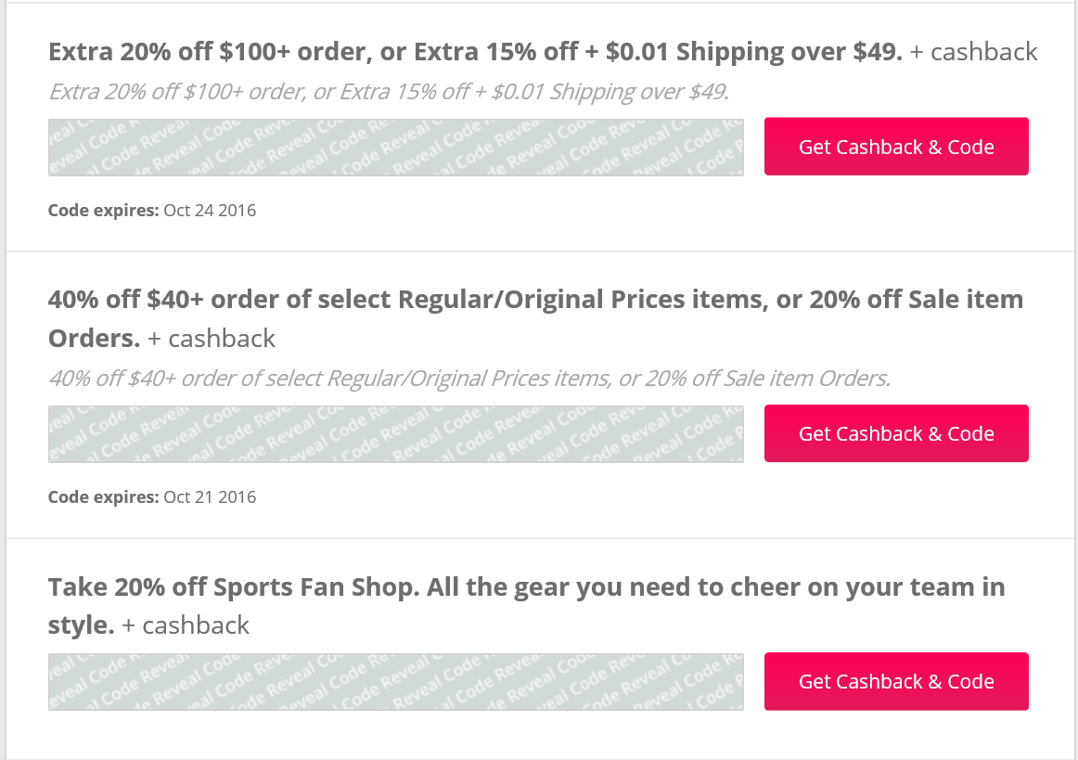
Q2: What were some alternative pricing strategies that Johnson might have considered besides “Fair and Square”?除了“公平合理，约翰逊可能考虑过的一些其他的定价策略有哪些呢？
（1）High-low pricing：高/低价格策略是指零售商制定的商品价格有时高于竞争对手，有时低于竞争对手，同一种商品价格经常变动，零售商会经常使用降价来进行促销。In many markets, high-low pricing results in higher revenues（产生高利润）. This is largely connected to the psychology associated with sale-shopping（销售和购买的心理因素）. Although consumers state in surveys that they prefer the convenience and savings of EDLP, they actually tend to purchase more when high-low pricing strategies are employed.
（2）psychological pricing ：每一件产品都能满足消费者某一方面的需求，其价值与消费者的心理感受有着很大的关系。
（3）promotion pricing：跟进促销定价
（4）Distribute Coupons： 恢复使用优惠券
（5）Reference pricing：参考定价

Slide 22
Q3：Why did “Fair and Square” fail to connect with JCPenney’s existing customers? Why have many retailers retreated from EDLP（Every Day Low Price）?为什么“公平合理”和杰西潘尼的现有客户脱节了？为什么有许多零售商退出天天平价？
（1）Market positioning and target customer is not clear. （定位不明确，在顾客心目中形象不清晰）Johnson said the company's horrible quarter was a "learning experience." "But the real lesson to me was that the customer, not just outside of the store, needs to understand the value. When they walk through the store, they want to understand the value of what they buy,” Johnson told analysts last week.
（2）Pricing strategies cause confusion among customers, losing customers royalty. （混乱的价格策略造成消费者模糊，失去顾客忠诚度）In August, 2012, six months after the initial “Fair and Square” launch, the month-long price reduction initiative was terminated with Johnson claiming it was too confusing for shoppers.
（3）So much discount information and so many advertisements that confused customers.（过多折扣信息造成消费者模糊）“I am complaining about the obnoxious television commercial aired （电视广告播出）announcing your new pricing campaign,” wrote a shopper on consumeraffairs.com. “It has to be one of the most irritating, annoying commercials ever created for television. If you think this will make anyone shop at your stores, you are mistaken.”

Slide 23
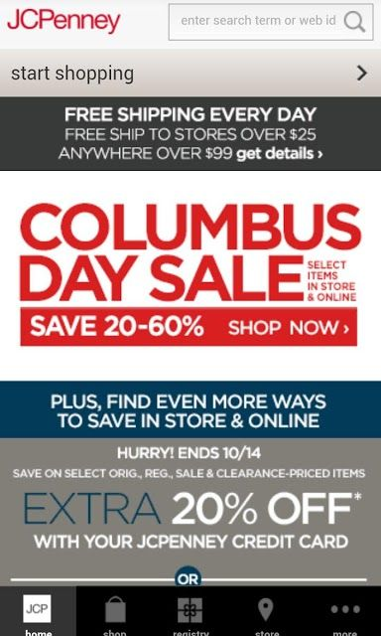
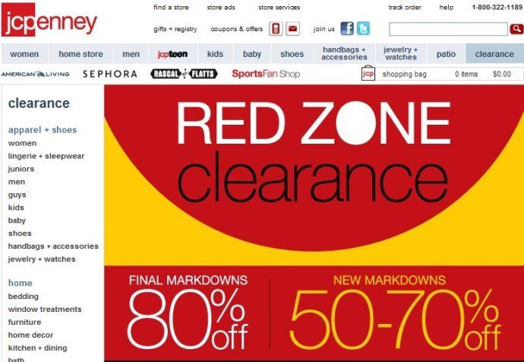

Slide 24
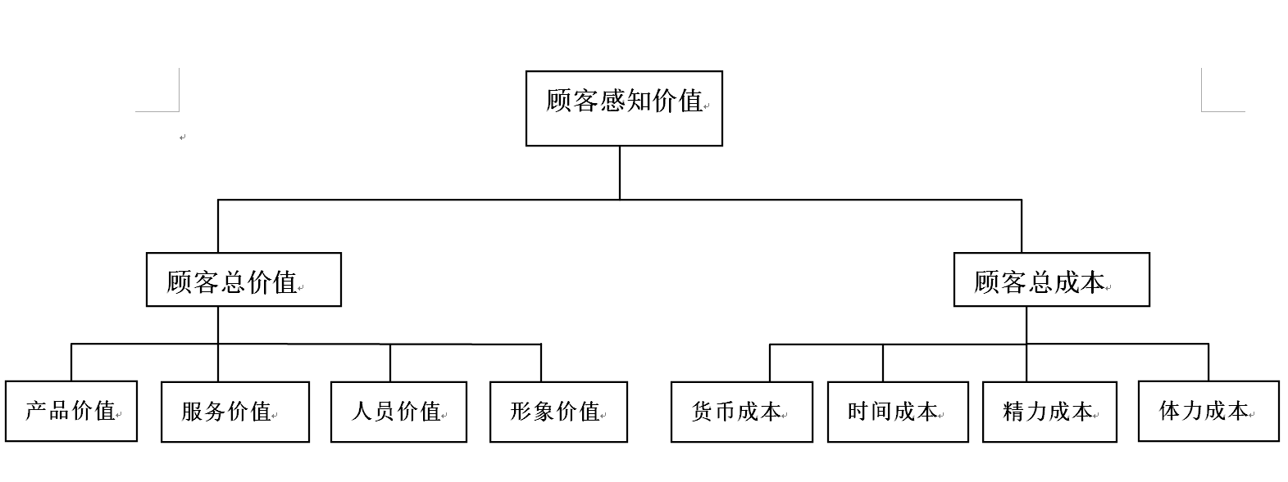
（4）Eliminate the coupons.（取消优惠券，引起不满）Taking coupons away from a couponer is like taking vodka away from an alcoholic,” says Faith Popcorn, a consumer trend strategist and CEO of Brain Reserve in Manhattan, who stresses that at this particular moment in time（在特殊时期）, savings are important to every consumer, from the richest to the poorest, especially where coupons are concerned. It seems like Johnson and his team overlooked one critical component in the decision to eliminate coupons（忽视了优惠券的重要作用） from Penney’s marketing strategy.
（5）Low customer perceived value（低顾客感知价值）

Slide 25
（6）Lack of unique competitive power.（缺少独特竞争力，模仿对手） The stores are remodeled into store-in-store layout is similar to Target. The “town square” is similar to Apple.

Slide 26
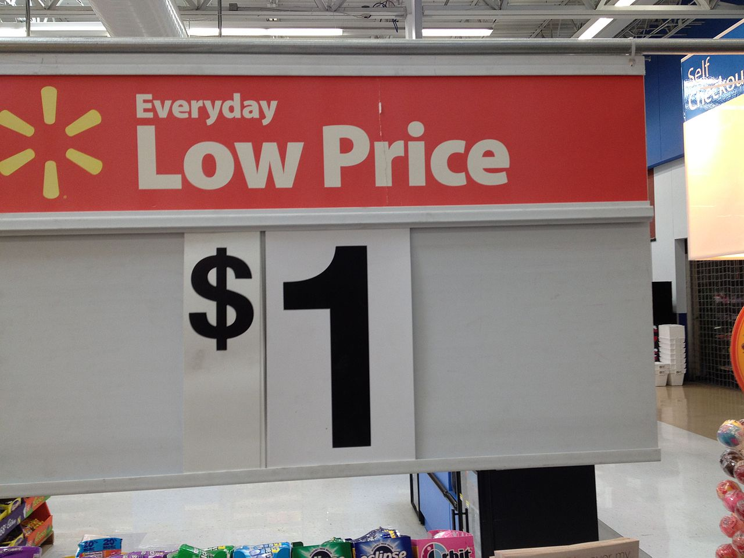
EDLP：Everyday low price (also abbreviated as EDLP) is a pricing strategy （价格策略）promising consumers a low price without the need to wait for sale price events or comparison shopping.
（1）High Cost，low benefit.（高成本,低利润）: total costs for EDLP are higher in many markets, and it is extremely expensive for retailers to switch strategies（战略转换成本高）. Not only is the initial cost high, but the EDLP strategy must be maintained long enough（足够长的时间） for consumers to associate lower prices with the brand.
（2）Customer loyalty and customer confidence（顾客忠诚度和顾客信任）Your company stands to lose credibility among consumers（失去顾客信任） if your everyday low prices are not comparable to pricing found on the Internet, according to the Knowledge@Emory website. And if you do not use it effectively and efficiently, you will confuse your customers and drive them to your competitors（误导消费者，并且把消费者让给你的竞争对手）.
（3）Fierce competition（竞争激烈）.

Slide 27
Q4： Was JCPenney attempting to attract a new customer? If so, describe.杰西潘尼有试图吸引新客户吗？如果有，请描述。
1、New pricing strategy（新的定价策略试图留住老顾客，吸引新顾客）
2、New merchandising and store layout plans（新的商品推销规划和商店布局计划）
3、Omnichannel shopping methods（全渠道购买途径）
The company has also embraced the omnichannel merchandising（全渠道商品推销） philosophy giving customers a seamless shopping experience（无漏洞的购物体验） in stores and on line. This approach is likely to increase the frequency that customers shop at J.C.Penney.

Slide 28
4、reference pricing（实施参考定价以吸引顾客）Johnson‘s latest strategy is making it easier for shoppers to do price comparisons while they shop（让顾客购买时容易进行价格比较） , showing “suggested price” alongside “retail price” to show the value（在零售价格旁边标注建议售价来现实商品价值）. The company will also have a series of promotions（进行促销）, including on Black Friday. The company’s management is hopeful that changing up JCPenney‘s marketing and promotions will help the retailer regain lost foot traffic（重新获取人流量）.
While it goes through growing pains, JCPenney‘s challenge is two-fold: attracting new, value-conscious customers while keeping its old customers happy（吸引新的有价值意识的顾客，同时让老顾客感到愉悦）——How to improve customer perceived value（如何提高顾客感知价值）.

Slide 29
Q5： What steps could JCPenney have taken, if any, to have increased the chances of success for “Fair and Square”?
如果有的话，杰西潘尼采取了什么措施，增加了“公平合理”成功的机会？
1、Implement reference pricing（实施参考定价） by adding new MSRP price tags to more than half its merchandise
2、 resume the practice of distributing coupons.（重新使用优惠券）

